Slide 1
A Novel Evolving Classifier with a False Alarm Class for Speed Limit Sign Recognition
Thihagoda Gamage Pubudu Sanjeewani
PhD Candidate (Post CoC), ARC Linkage Project Scholarship
p.thihagodagamage@cqumail.com
Principal Supervisor: Prof. B. Verma
Associate Supervisor: Dr. Mary Tom
This paper has been published in IEEE Congress on
Evolutionary Computation (CEC) held in Kraków, Poland, 2021.
An ERA listed, CORE ranked, Tier B conference

Slide 2
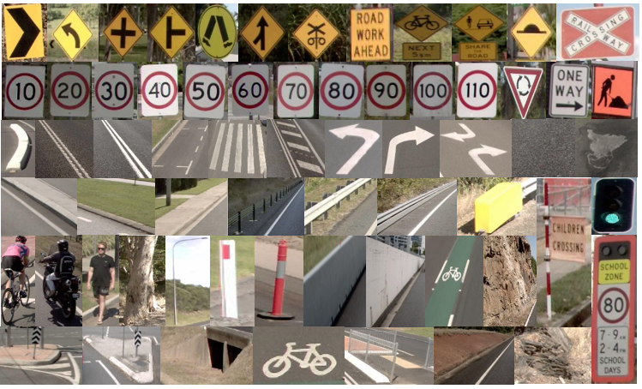
Introduction
The main purpose is to develop an Australian Road Assessment Program (AusRAP) attributes detection system.
The goal is to detect and identify all road attributes to assess road safety.
AusRAP Attributes
2

Slide 3
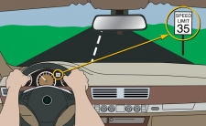
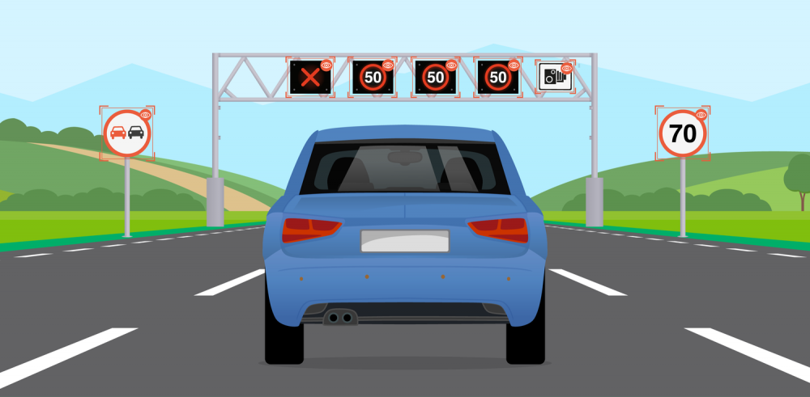
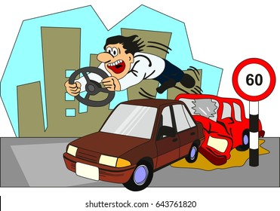


Continued..
Autonomous Driving
Road Surveying
Road Safety
School Zone
Road Works
Source: Google Images
3

Slide 4




Problem Statement
High similarity of signs
Poor visibility of signs
Challenging nature of road environment
Misclassification of many attributes with text
Source: Google Images
4

Slide 5
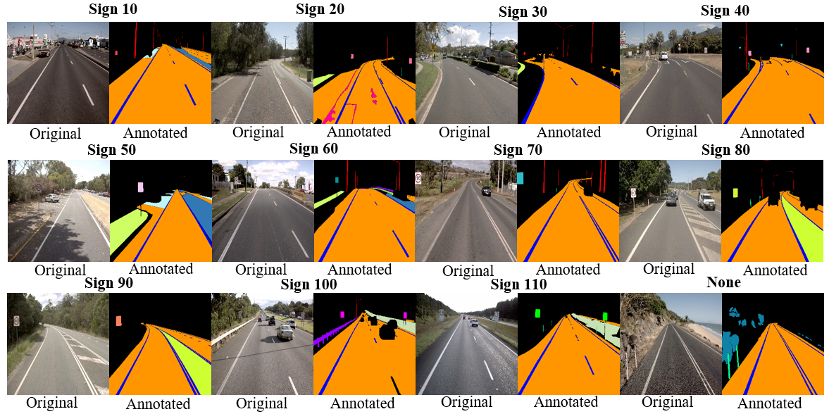
What is Proposed ?
We propose,
a Fully Convolutional Network (FCN) with all signs into one class to segment sign pixels into Region of Interests (RoIs) for accurately identifying speed signs in our AusRAP safety attribute detection
and,
a novel evolving classifier with a false alarm class that classifies detected pixels into individual signs or non-signs.
Speed Sign Frames and Corresponding Annotations
5

Slide 6
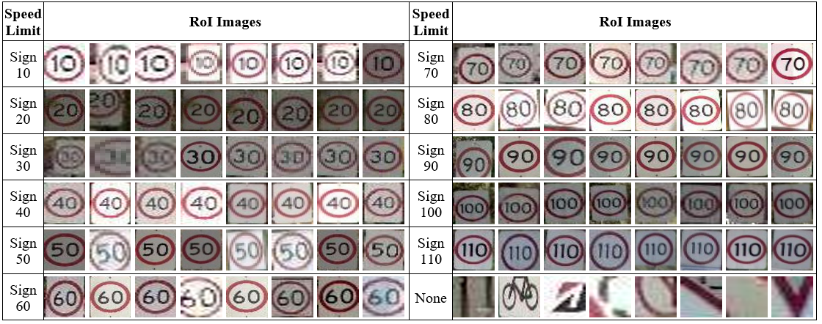
Data Preparation
RoI Images Input to Evolved Classifier
6

Slide 7
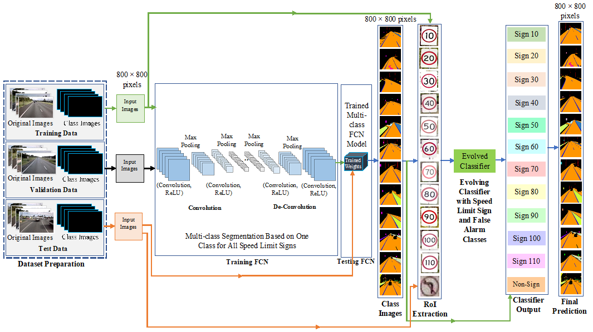
Proposed Technique
Detection
Classification
Proposed Technique

Slide 8
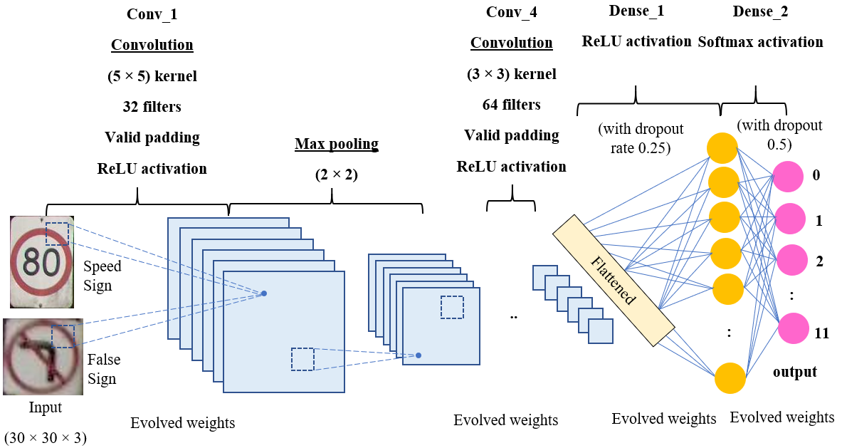
Architecture of the Proposed Classifier
Architecture of the Proposed Classifier

Slide 9
Evolutionary Process for Classifier Training
Step 1: Pre-processing and resizing of detected RoIs into 30×30 images and creating a vector for 12 classes.
Step 2: Setting initial parameters including population (set of individuals), generation and epochs.
Step 3: Initializing population with different values of random weights for the classifier.
Step 4: Calculating the fitness of each individual in the population based on accuracy on validation set.
Step 5: Selecting the number of individuals from the population based on fitness.
Step 6: Performing the crossover and mutation of 6-layer weights to form better classifier weights.
Step 7: Repeating steps 4-6 until number of generations are reached.

Slide 10
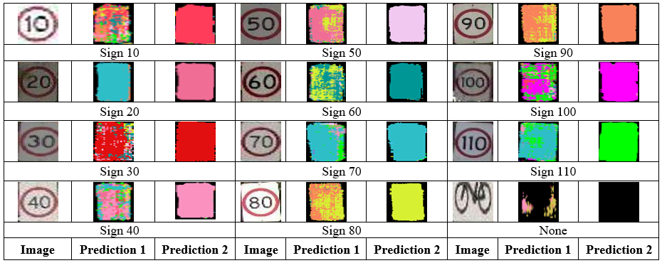
Visual Results
Sample Prediction Results Obtained by the Proposed Technique With (Prediction 2) and Without (Prediction 1) Our Novel Classifier with a False Alarm Class

Slide 11
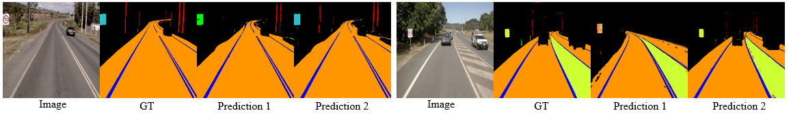
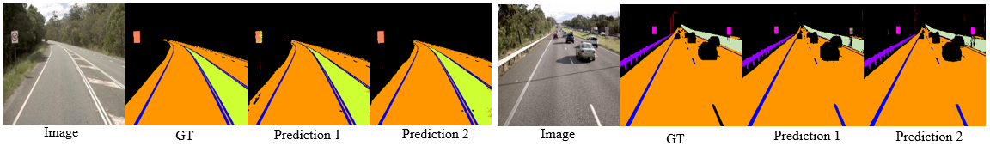
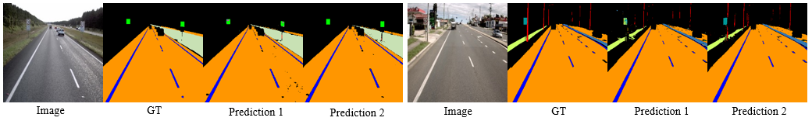
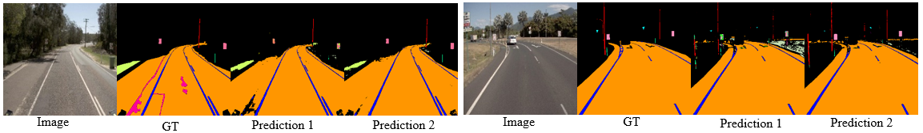
Continued..
Prediction 1: Without Classifier
Prediction Results of Sign 70 (First Set) and Sign 80 (Second Set).
Prediction 2: With Classifier
Prediction Results of Sign 90 (First Set) and Sign 100 (Second Set).
Prediction Results of Sign 110 (First Set) and Sign 60 (Second Set).
Prediction Results of Sign 20 (First Set) and Sign 40 (Second Set).
11

Slide 12
Numeric Results
Best Accuracy and Misclassifications Obtained by the FCN Classification Technique
Best Accuracy and Misclassifications Obtained by the OCR Classifier based Technique
Speed Limit | Accuracy (%) |  | Misclassifications (%)
 | Attribute Wise | Pixel Wise
Sign 10 | 50.00 | 48.00 | 0.94
Sign 20 | 33.34 | 13.00 | 1.89
Sign 30 | 0.00 | 0.00 | 0.94
Sign 40 | 33.34 | 28.00 | 0.94
Sign 50 | 0.00 | 0.00 | -
Sign 60 | 66.69 | 36.00 | -
Sign 70 | 14.29 | 12.00 | -
Sign 80 | 100.00 | 76.00 | 0.00
Sign 90 | 50.00 | 50.97 | 0.94
Sign 100 | 75.00 | 46.00 | 0.94
Sign 110 | 50.00 | 36.00 | -
Speed Limit | Attribute Wise Accuracy (%) | Misclassifications (%)
Sign 10 | 50.00 | 0.00
Sign 20 | 100.00 | 0.00
Sign 30 | 0.00 | 0.00
Sign 40 | 33.33 | 0.00
Sign 50 | 100.00 | 0.00
Sign 60 | 16.67 | 2.17
Sign 70 | 85.71 | 0.00
Sign 80 | 0.00 | 0.00
Sign 90 | 0.00 | 0.00
Sign 100 | 50.00 | 0.00
Sign 110 | 75.00 | 2.17
Best Accuracy and Misclassifications Obtained by Proposed Technique
Speed Limit | Accuracy (%) | Misclassifications (%)
Sign 10 | 50.00 | 0.027
Sign 20 | 100.00 | 0.00
Sign 30 | 100.00 | 0.00
Sign 40 | 100.00 | 0.00
Sign 50 | 100.00 | 0.00
Sign 60 | 100.00 | 0.00
Sign 70 | 85.71 | 0.027
Sign 80 | 100.00 | 0.00
Sign 90 | 100.00 | 0.00
Sign 100 | 100.00 | 0.00
Sign 110 | 100.00 | 0.00
Non-signs (False alarm) | 100.00 | 0.00
12

Slide 13
Comparative Analysis
Comparison of Classification Accuracy
Speed Limit | Attribute Wise Accuracy (%)
 | Proposed Technique | Proposed Technique with OCR | Proposed Technique with FCN
Sign 10 | 50.00 | 50.00 | 50.00
Sign 20 | 100.00 | 100.00 | 33.34
Sign 30 | 100.00 | 0.00 | 0.00
Sign 40 | 100.00 | 33.33 | 33.34
Sign 50 | 100.00 | 100.00 | 0.00
Sign 60 | 100.00 | 16.67 | 66.69
Sign 70 | 85.71 | 85.71 | 14.29
Sign 80 | 100.00 | 0.00 | 100.00
Sign 90 | 100.00 | 0.00 | 50.00
Sign 100 | 100.00 | 50.00 | 75.00
Sign 110 | 100.00 | 75.00 | 50.00
False alarms | 100.00 | NA | NA

Slide 14





Conclusion
A novel technique for detection and classification of speed limit signs.
Implemented and evaluated on a large real-world dataset from industry.
Proposed technique produces the best classification accuracy and minimum misclassifications.
False alarm reduced to zero.
The overall accuracy achieved by the proposed technique is much higher than accuracy obtained by other existing techniques.
Source: Google Images
14

Slide 15
Publications
Journals
P. Sanjeewani and B. Verma, “Single class detection-based deep learning approach for identification of road safety attributes,” Neural Computing and Applications, vol. 33, pp. 9691–9702, 2021.
P. Sanjeewani and B. Verma, “Optimization of fully convolutional network for road safety attribute detection,” IEEE Access, vol. 9, pp. 120525-120536, 2021.
T. G. P. Sanjeewani and B. Verma, “Learning and analysis of AusRAP attributes from digital video recording for road safety,” in 34th International Conference on Image and Vision Computing New Zealand, Dunedin, New Zealand, 2019, pp. 1-6.
P. Sanjeewani and B. Verma, “An optimization technique for the detection of safety attributes using roadside video data,” in 35th International Conference on Image and Vision Computing New Zealand, Wellington, New Zealand, 2020, pp. 1-6.
P. Sanjeewani, B. Verma and J. Affum, “A novel evolving classifier with a false alarm class for speed limit sign recognition,” in IEEE Congress on Evolutionary Computation, Kraków, Poland, 2021, pp. 2211-2217.
P. Sanjeewani, B. Verma and J. Affum, “Multi-stage deep learning technique with cascaded classifier for improving turn lanes recognition,” IEEE Symposium Series on Computational Intelligence, Orlando, Florida, USA, 2021.
P. Sanjeewani, B. Verma and J. Affum, “Multi-stage deep learning technique for improving traffic signs recognition,” in 36th International Conference on Image and Vision Computing New Zealand, Waikato, New Zealand, 2021, pp. 1-6.
Conferences

Slide 16


Source: Google Images

Slide 17

Q & A
Source: Google Images

Slide 18
Supplementary Slides

Slide 19
Evolutionary Algorithms and Architectural Parameters for the Proposed Classifier
Evolving Parameters (Min/Max Values in Our Experiments) | Input and Output Parameters | Number of Evolving Layers | Number of Other Layers
Number of generations: min 5 and max 200 | Input size 30×30×3 (resized detected RoI) | Conv2D (32, kernel size = (5, 5), activation = ReLU) | MaxPooling2D (pool size = (2,2)
Number of individuals: min 10 and max 100 |  | Conv2D (filters = 32, kernel size = (5,5), activation = ReLU) | Dropout (0.25)
Number of epochs: min 1 and max 50 |  | Conv2D (filters = 64, kernel size = (3, 3), activation = ReLU) | MaxPooling2D (pool size = (2,2)
Mutate factor: 0.05 | Output size 12 (11 for speed signs and 1 for false alarms) | Conv2D (filters = 64, kernel size = (3, 3), activation = ReLU) | Dropout (rate=0.25)
 |  | Dense (256, activation = ReLU) | Flatten ()
 |  | Dense (12, activation = Softmax) | Dropout (0.5)

Slide 20
A Sample of Generations
Generation 1:
[2.4199, 2.4533, 2.4495, 2.4574, 2.4538, 2.4502, 2.4277, 2.424, 2.435, 2.4544]
20/20 [==============================] - 1s 56ms/step - loss: 2.3263 - accuracy: 0.1571 - val_loss: 2.1675 - val_accuracy: 0.3758
20/20 [==============================] - 1s 58ms/step - loss: 1.7056 - accuracy: 0.4503 - val_loss: 0.7705 - val_accuracy: 0.8153
20/20 [==============================] - 1s 58ms/step - loss: 1.7444 - accuracy: 0.4343 - val_loss: 0.7938 - val_accuracy: 0.7580
Generation 2:
[2.3263, 2.3223, 2.3751, 2.2884, 2.1214, 2.4202, 1.2107, 1.7056, 2.3321, 1.7444]
20/20 [==============================] - 1s 58ms/step - loss: 0.5806 - accuracy: 0.8189 - val_loss: 0.2290 - val_accuracy: 0.9490
20/20 [==============================] - 1s 60ms/step - loss: 0.3196 - accuracy: 0.9103 - val_loss: 0.1444 - val_accuracy: 0.9809
Generation 3:
[0.5806, 0.7859, 0.4164, 0.2897, 0.3235, 0.8239, 0.2353, 0.1665, 0.4943, 0.3196]
20/20 [==============================] - 1s 57ms/step - loss: 0.1615 - accuracy: 0.9599 - val_loss: 0.1511 - val_accuracy: 0.9618

